Slide 1

Azure Arc: Extend management & governance to any infrastructure
Brad “Mega” Watts
Marshall Sweeney

Slide 2
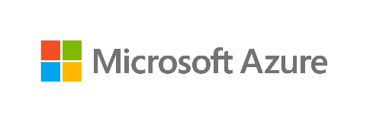

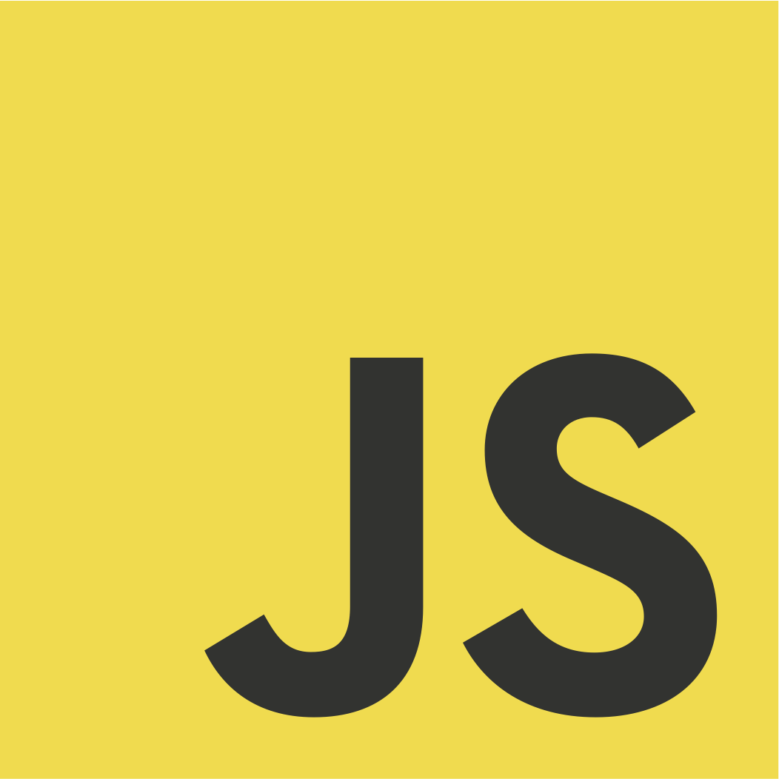
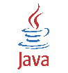

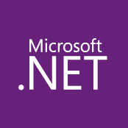



Your environments are increasingly complex
10s–1,000s of apps
Diverse infrastructure
Multi-cloud
VMs
Databases
Datacenters
Hosters
Containers
Serverless
Branch offices
OEM hardware
IoT devices
Edge
Notes:
How to govern and operate disparate environments at scale?
How to ensure integrated security across the entire organization?
How to best enable innovation and developer agility?

Slide 3



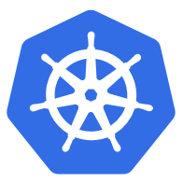

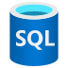



Azure Hybrid
Innovation anywhere with Azure
Microsoft Azure
Azure Stack
Azure Arc
Azure IoT
Integrated systems
Any datacenter, any cloud
Any edge device
Management | Security + Identity | App + Data Services | Dev Tools + DevOps

Slide 4


WHAT IF YOU COULD ... …LEVERAGE AZURE’S AWESOME MANAGEMENT CAPABILITIES ON RESOURCEs OUTSIDE OF AZURE?
Reminder us to talk about Lighthouse at some point this morning

Slide 5
Azure Arc
Bring Azure services and management to any infrastructure
Run Azure Data Services anywhere
Extend Azure management across your environments
Adopt cloud practices on-premises
Implement Azure security anywhere
Azure Arc is a set of technologies that extends Azure management and enables Azure services to run across on-premises, multi-cloud, and edge

Slide 6
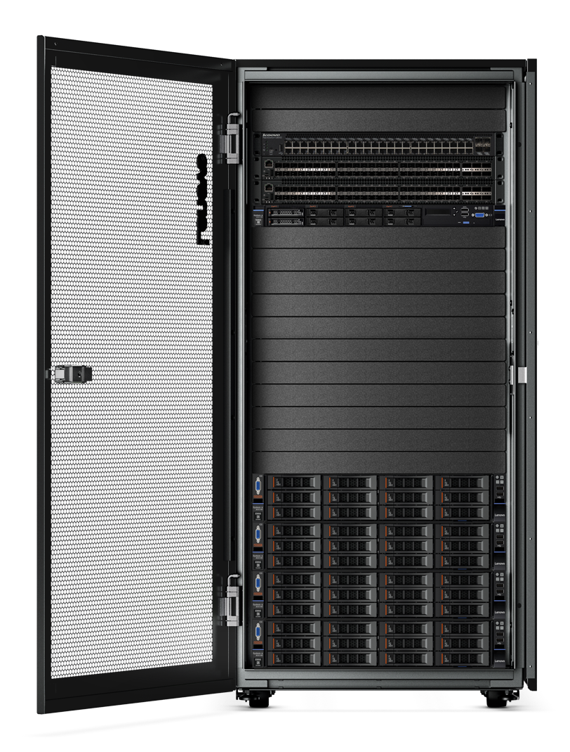
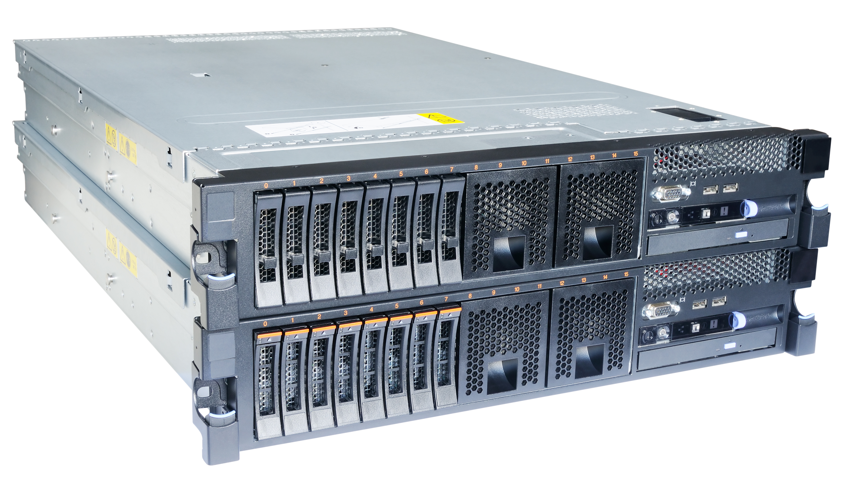
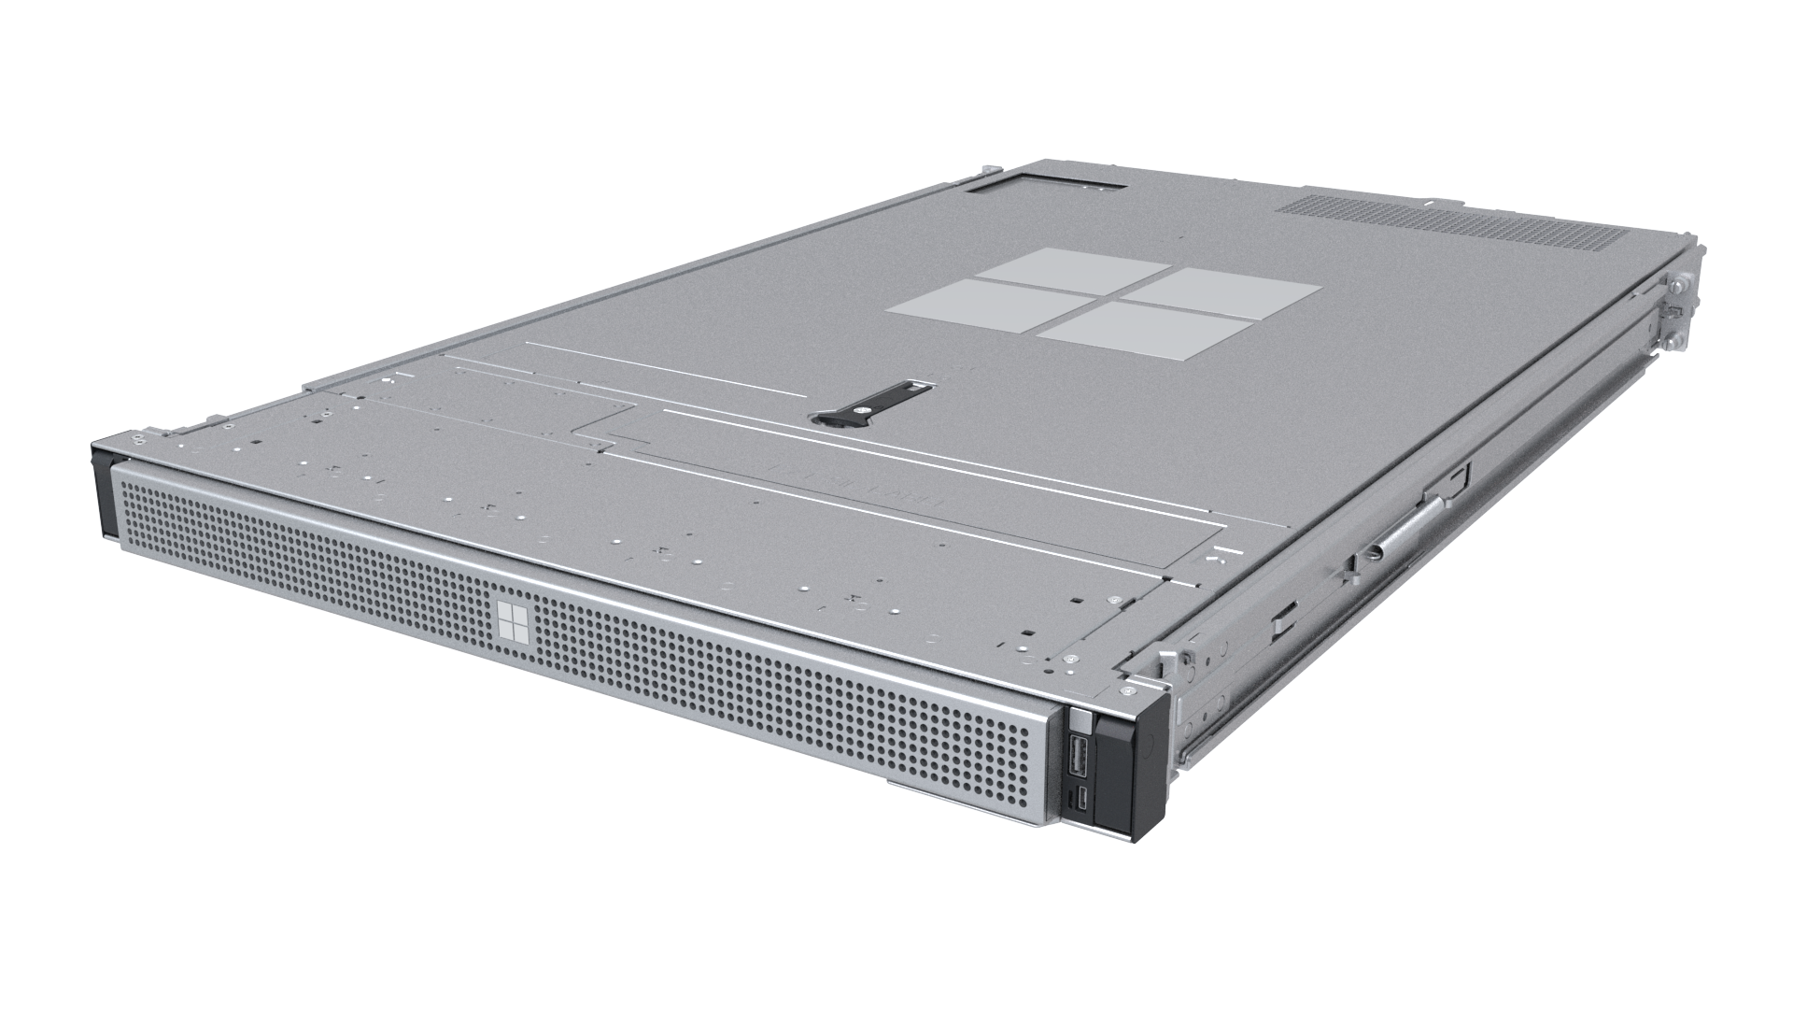
Modernize datacenters with Azure Stack
Azure Stack Hub
Cloud-native integrated system
Azure Stack HCI
Hyperconverged solution
Azure Stack Edge
Cloud-managed appliance
Disconnected scenarios
Data sovereignty
Application modernization
Scalable virtualization and storage
Remote branch office
High-performance workloads
Machine learning at the edge
Edge compute and IoT solutions
Network data transfer to cloud
Notes:
The Azure Stack portfolio includes three offerings that extend Azure services and capabilities across datacenters, remote offices, cloud and edge locations.
The portfolio makes it possible to build and run hybrid and edge computing applications consistently across environments, providing you with choice and flexibility to address diverse workloads.
The Azure stack portfolio offers three different solutions:
And Azure Stack Hub is an integrated system that provides the full stack of Azure services on-premises. Since its launch over two years ago, Azure Stack Hub is available in more than 60 countries. It’s a proven technology, can run in both connected and disconnected environments, important scenarios to many customers. Azure Stack Hub also gives customer choice of hardware vendors.
Azure Stack HCI is optimized for running virtualized applications on-premises and provides easy access to Azure services.
Azure Stack Edge is an Azure-managed appliance that brings compute, storage and intelligence to the edge.

Slide 7


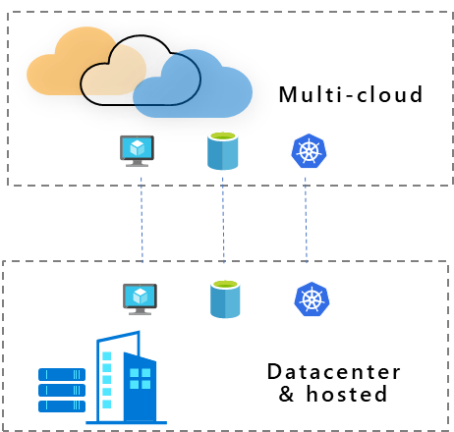
Azure Arc
use cases
Multi-cloud
Datacenter & hosted
Organize and govern across environments
At-scale Kubernetes app management
Run data services anywhere
Get Kubernetes clusters and servers that are sprawling across clouds, datacenters and edge under control by centrally organizing and governing from a single place.
Deploy and manage Kubernetes applications at scale across environments using DevOps techniques. Ensure that applications are deployed and configured consistently from source control, at scale.
Deploy and manage data services where you need it for latency or compliance reasons. Always use the most current technology and seamlessly manage and secure your data assets across on-premises, clouds and edge.

Slide 8

Azure data services anywhere
Bring Azure data services to on-premises, multi-cloud, and edge with Azure Arc
Always current
Elastic scale
Unified management
Unmatched security
Cloud billing
Automated updates
Evergreen SQL
Hyperscale on-premises
Deploy in seconds
Scale up, scale out
Automation at scale
Single view for on-premises and clouds
Use familiar tools
Advanced Data Security
Azure Policy
Role-based Access Control
Cloud billing on-premises
Cost efficiency
Any hardware, any Kubernetes
Notes:
A crucial benefit of Azure Arc is that it makes it possible to run Azure data services on any Kubernetes cluster, whether that’s on-premises, at the edge or in a multi-cloud environment.
This currently includes 2 services, with more data services to come soon:
The first is Azure SQL Database
And the other is Azure Database for PostgreSQL Hyperscale
Extending Azure services across environments provides a number of benefits:
First, like any cloud service, they stay up to date. You get automated updates, evergreen SQL, and hyperscale on-premises.
You also get cloud elasticity on-prem. Thanks to Kubernetes-based execution, you can deploy a database in seconds, setting up high availability, backup, point-in-time-restore with a few clicks. It also enables you to scale workloads up or down dynamically just like in Azure, based on available infrastructure capacity.
Next, you get a unified view of all Azure data services running across on-premises and clouds and you can apply consistent policy, security and governance across environments. You can use familiar tools like Azure Portal, Azure Data Studio, CLI or 3rd party to manage data across on-prem and cloud.
You get unmatched security with Azure security and role-based access control (RBAC)
And finally, you pay through a consistent cloud billing model to optimize costs

Slide 9
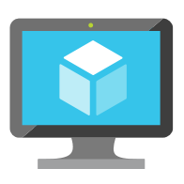
Customer scenario Organize & govern across environments
Overview
A large financial institution has sprawling server-based IT systems deployed in corporate datacenters, hosters, and cloud
In addition, new DevOps practices result in an unknown number of servers that are connected to the corporate networks but are running outside of identity and governance systems
The sprawl is overwhelming, and it is impossible to apply consistent governance across the environment and meet compliance needs
Business requirements
Manage a mix of bare metal, Windows and Linux servers
Visibility across locations, OS flavors and disparate systems
Enable IT to apply at scale governance and security policies across all servers
Enable application owners to apply and audit to meet their own requirements
Measure and remediate compliance at scale and down to the individual workload/server
Multi-cloud
Datacenter
& hosted

Slide 10
Customer scenario Solution
Multi-cloud
Govern across your environment
Asset organization and inventory with a unified view in the Azure Portal
Universal governance anywhere through Azure Policy
Built-in server compliance rules
Central compliance view across all servers
Server owners can view and remediate to meet their compliance
MSPs can implement governance for their customer’s environment
Azure Arc
Azure Management
(Azure Resource Manager, Azure Policy, Azure Portal, API, CLI…)
Azure Arc
On-premises
& hosted

Slide 11
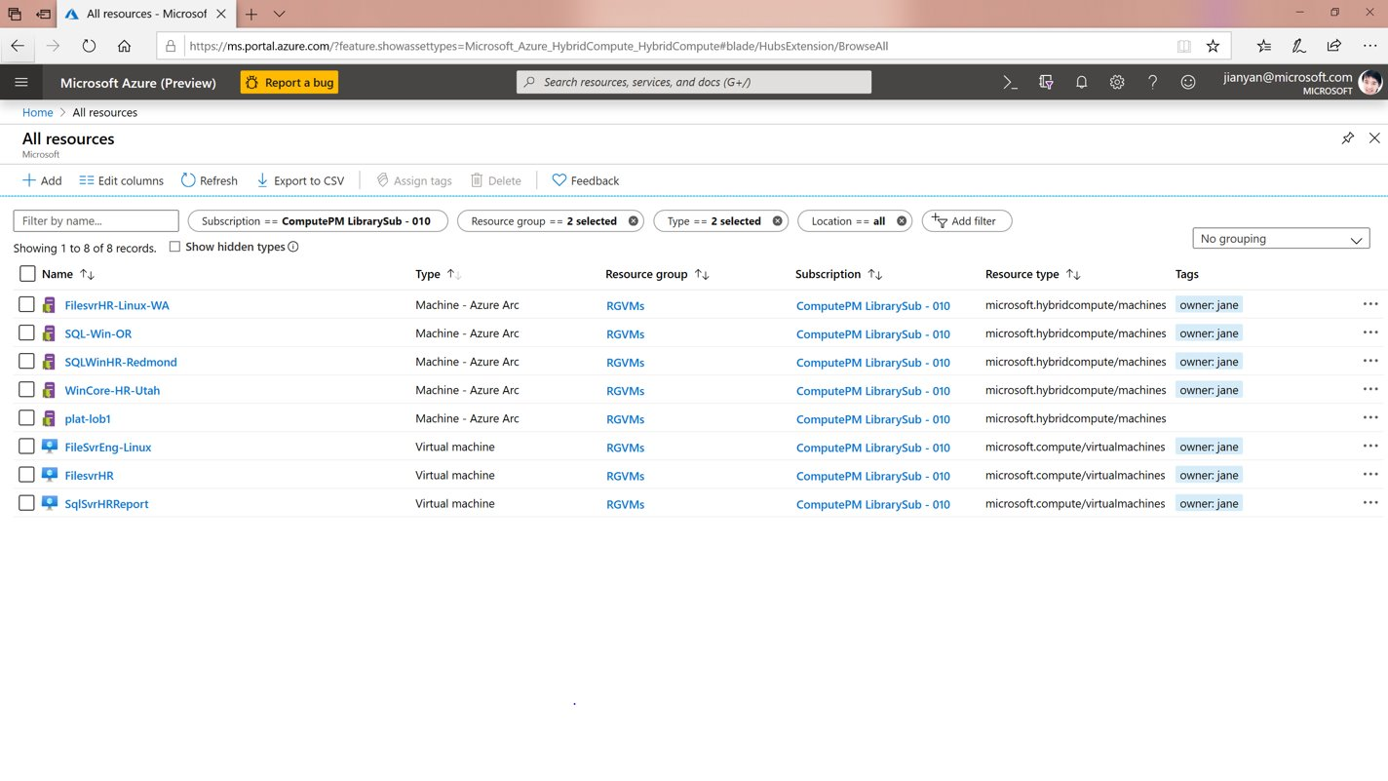

Slide 12
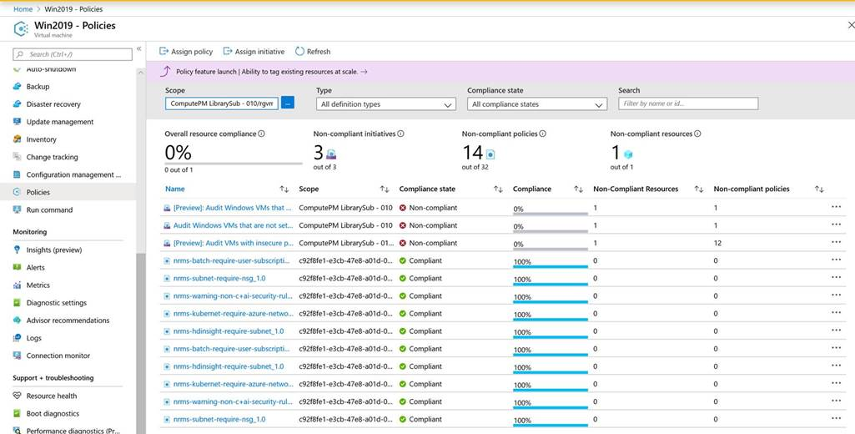

Slide 13
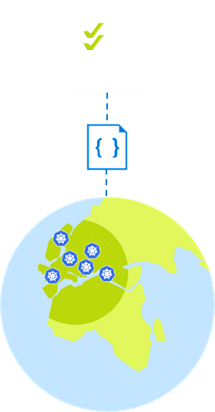
Customer scenario At-scale Kubernetes app management
Overview
A retailer with 100s of stores would like to move all in-store applications to containers running on a K8s clusters
They are faced with the challenge of how to uniformly deploy, configure and manage their containerized applications across multiple locations
Business requirements
Bootstrap a new store to fully run with the applications and configuration that this store requires
Enable IT to apply and monitor at scale governance across all stores
Monitor the state of applications and configuration in all stores
Integrate DevOps and Safe Deployment Practices for applications running in stores
Allow region/store IT to monitor and troubleshoot configuration issues for their stores

Slide 14
Customer scenario Solution
Key benefits from Azure Arc
Asset organization and inventory with a unified view in the Azure Portal across all locations
At scale configuration and deployment based on subscription, resource groups, and tags
GitOps-based model for deploying configuration as code to one or many clusters
Application deployment and update at scale
Source control based Safe Deployment Procedures when rolling new applications and configurations
Developer tooling agnostic—use the tools they want
Azure Management
(Azure Resource Manager, Azure Policy, Azure Portal, API, CLI…)

Slide 15
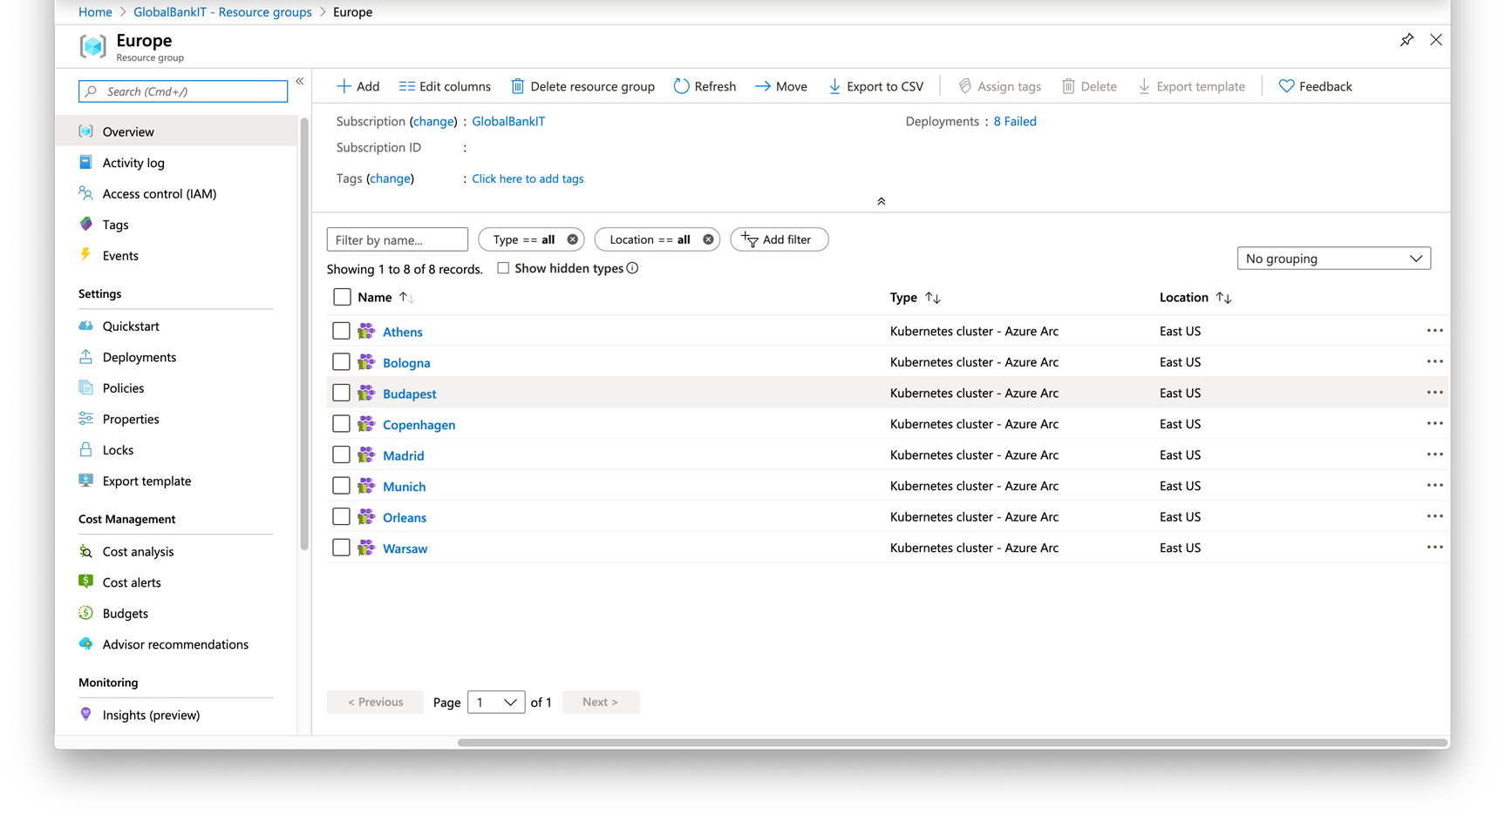

Slide 16
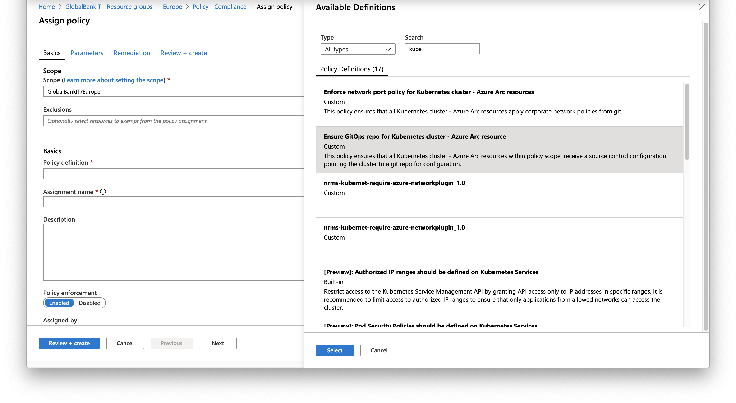

Slide 17
Azure Data Services enabled by Azure Arc

Slide 18




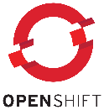

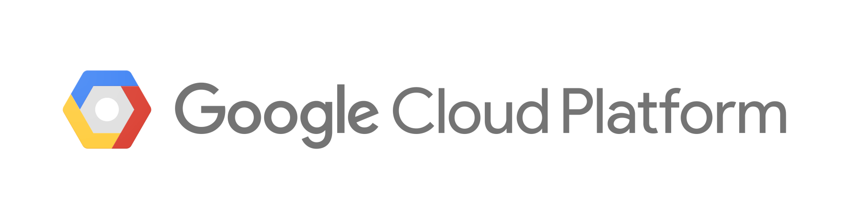


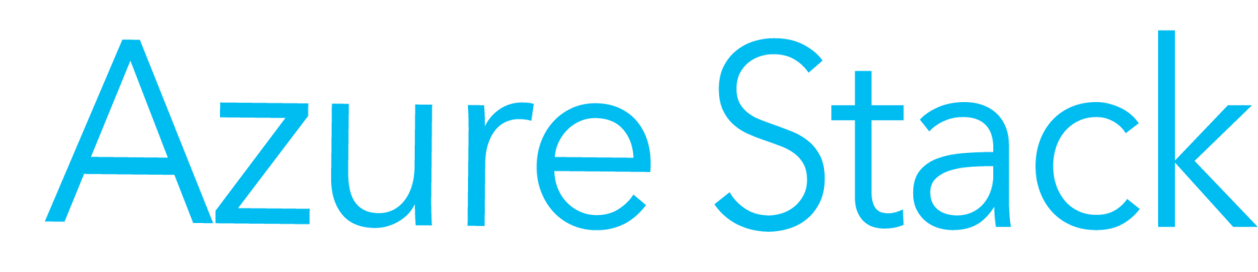
Azure Data Services anywhere at a glance
Apps and BI
Custom apps
BI
Analytics
Azure Data Services
…
Provisioning
Updates
Azure Arc management
HA/DR
Backup
Microsoft Azure Site Recovery
Scaling
Diagnostics
Azure Security
Monitoring
Azure Site Recovery
Any Kubernetes
Kubernetes
OpenShift
AKS
Any hardware
OEM hardware
Amazon EC2

Slide 19


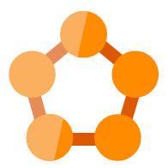
Azure management Single control plane for Azure resources
Management Services
Monitoring | Update | Containers | Backup | Security Center | More…
Access and security
RBAC | Locks | Subscriptions
Organization and inventory
Search | Index | Groups | Tags
Tools and experiences
Portal
Shell
Bash
CLI
Ecosystem
Marketplace
Azure Resource Manager
Azure customers
Environments and automation
Templates | Extensions
Governance and compliance
Logs | Policy | Blueprints
Over 200 services
Extensibility for new Resources
Azure Services
Azure

Slide 20
Azure management Single control plane for Azure resources
Management Services
Monitoring | Update | Containers | Backup | Security Center | More…
Access and security
RBAC | Locks | Subscriptions
Organization and inventory
Search | Index | Groups | Tags
Tools and experiences
Portal
Shell
Bash
CLI
Ecosystem
Marketplace
Azure Resource Manager
Azure customers
Environments and automation
Templates | Extensions
Governance and compliance
Logs | Policy | Blueprints
Azure Arc
Azure Services
Local tools
Azure Data Studio
K8s Native Tools
Azure
Customer locations
Server Admin Tools

Slide 21

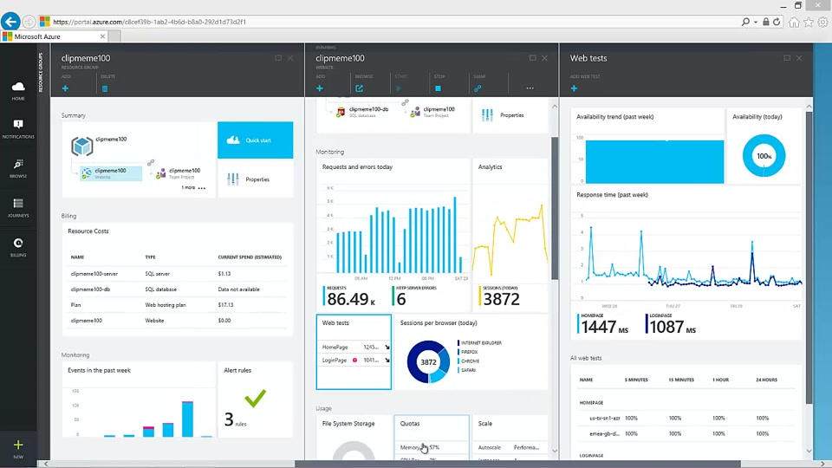
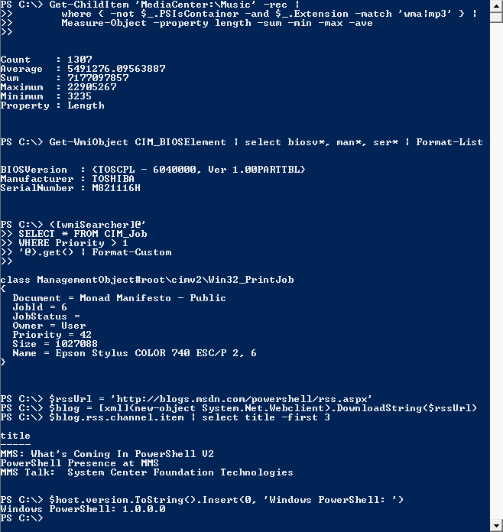

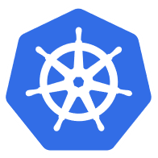
Azure Management Single Control Plane for Azure native and Azure Arc resources
Tools and experiences
Portal
Shell
Bash
CLI
Ecosystem
Marketplace
Management Services
Monitoring | Update | Containers | Backup | Security Center | More…
Access and security
RBAC | Locks | Subscriptions
Organization and inventory
Search | Index | Groups | Tags
Azure Customers
Azure Resource Manager
Environments and automation
Templates | Extensions
Governance and compliance
Logs | Policy | Blueprints
Azure Arc
Azure Resources
local tools
Azure Data Studio
Your environment - locations
K8s Native Tools
Windows Admin Center
Azure
System center suite
Server management tools

Slide 22
Key takeaways for Azure Arc for servers
Inventory
Windows and Linux servers
Physical and virtual machines
Private datacenter and other hosted cloud
Domain agnostic
Governance and security
Available built-in policies manage Azure and Azure Arc servers
Security baseline policy
One place to view compliance
Role based access
Central IT at scale operations
Workload owners manage based on their access
Lighthouse for MSPs
Resource centric log access
One central place to manage at-scale
Searchable inventory
Consistent experience through the Portal
Organize resources using Tag

Slide 23
Azure Arc
Azure
Customer locations
Management experiences
Azure Resource Manager
Azure Data Services
Resource specific tools
Azure Arc data agent
Wave 1
SQL
PostgreSQL
Azure Data Studio
Azure Portal
Azure CLI
Identity
Azure SDK
Azure Arc data RP
Azure Arc data controller
RBAC
K8s Native Tools
Container registry
Kubernetes
Cluster provisioning​
Cluster upgrade and patch management​
Cluster lifecycle management​
Cluster monitoring
Policy
GitOps Manager
Azure PaaS Control
Index
Azure Arc K8s RP
Azure Arc K8s agent
K8s Cluster
Groups
Azure Arc server RP
Servers
Linux
Server Admin Tools
Etc.
Azure Arc server agent
Windows Server
Azure Arc technologies

Slide 24
Q&A
Notes:
We’re going to stay online for another 10min so you have enough time to ask you rquestions.

Slide 25
Get going
Azure Arc Announcement Blog: aka.ms/Announcing-Azure-Arc
Azure Arc: Extending Azure management to any infrastructure: aka.ms/azblog/Ignite19Arc
Bring Azure data services to your infrastructure with Azure Arc: aka.ms/RKBlog/Ignite2019Arc
Read
Introducing Azure Arc: https://aka.ms/Bring-Azure-Hybrid-To-Any-Infra
Azure Arc MS Ignite session: https://aka.ms/Azure-Arc-Overview
Organize & govern across environments: https://aka.ms/AzureArcOrganizeInfraDemo
At scale Kubernetes App management: aka.ms/AzureArcManageAppsDemo
Run Azure data services anywhere: aka.ms/AzureArcDataAnywhereDemo
Watch
Start managing servers with the Azure Arc public preview: aka.ms/hybridmgmt
Sign up to be contacted with more information: aka.ms/Azure-Arc-Info
Visit Tech Docs to see how it all works: aka.ms/Azure-Arc-Docs
Do
Notes:
Description > AKA(linked)

Slide 26
Thank you for exploring with us.

Slide 27

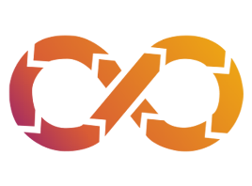





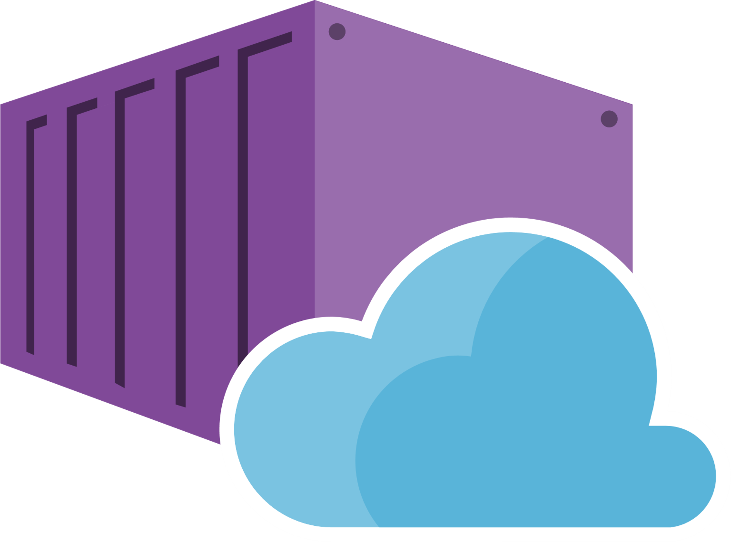

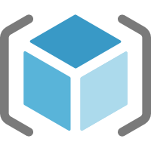

Speed + Control
Cloud-native governance -> removing barriers to compliance and enabling velocity
Management Groups
Management
Groups
Cost Management
Operational Standards
Resource Organization
Security
Cost Control
Business Continuity
Regulations
Compliance
Cloud Sprawl Prevention
Developers
Cost
Management
Resource
Graph
Cloud Engineers
Operations
Policy
Blueprints
Templates
RBAC
Policies
Notes:
SMART governance: enabling velocity through native controls
Showing how policy, cost, arm security still allows the development teams to execute at the velocity that the need while IT manages as a custodian natively without getting in the way
When it comes to cloud management platforms and brokers, we are approaching this differently. We are integrating the governance into the cloud, rather than a shim between the cloud and the customer.

Slide 29
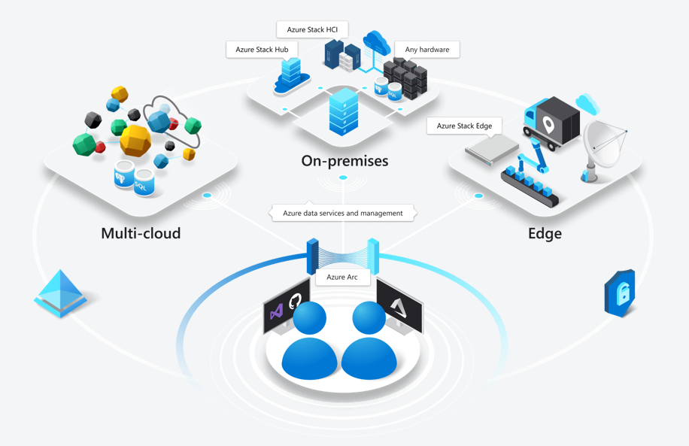
Why Azure Arc for Multi-platform Management

Slide 30
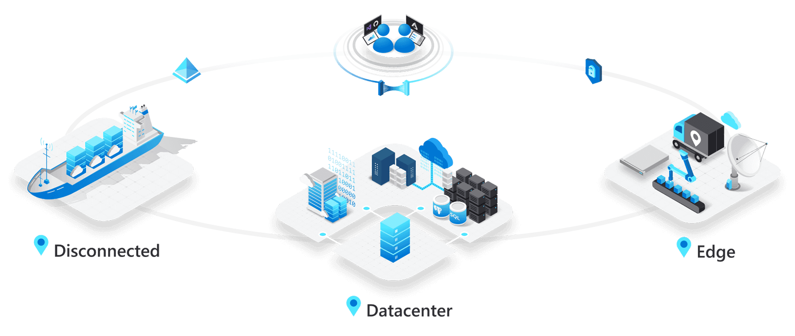

Slide 31





Azure Hybrid
Microsoft Azure
r
Azure Stack
Azure IoT
Integrated systems
Any edge device
Management | Security + Identity | App + Data Services | Dev Tools + DevOps
Notes:
Other options:
Tooling & DevOps
Developer tooling

Slide 32
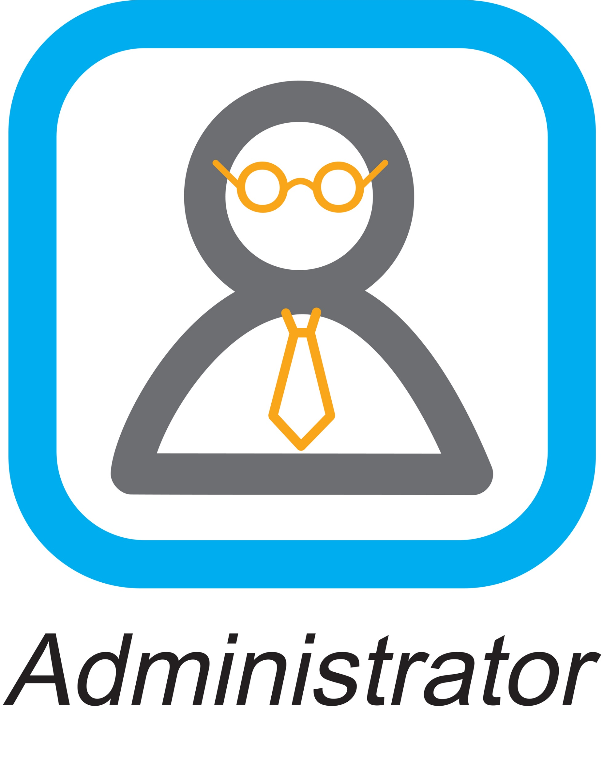
Customer environments are increasingly complex
Central IT Cloud Custodian
10s - 1,000s of apps
Diverse infrastructure
Multi-cloud
VMs
Databases
Datacenters
Hosters
Containers
Serverless
Branch offices
OEM hardware
IoT devices
Edge
Notes:
How to govern and operate disparate environments at scale?
How to ensure integrated security across the entire organization?
How to best enable innovation and developer agility?

Slide 33
Azure Arc
Bring Azure services and management to any infrastructure
Run Azure data services anywhere
Extend Azure management across your environments
Adopt cloud practices on-premises
Implement Azure security anywhere
Azure Arc is a set of technologies that extends Azure management and enables Azure services to run across on-premises, multi-cloud, and edge.

Slide 34
Azure Hybrid
Innovation anywhere with Azure
Microsoft Azure
Microsoft Azure
Azure Stack
Azure Arc
Azure IoT
Integrated systems
Any datacenter, any cloud
Any edge device
Management | Security + Identity | App + Data Services | Dev Tools + DevOps
Run Azure data services anywhere
Extend Azure management across your environments
Adopt cloud practices on-premises
Implement Azure security anywhere

Slide 35
Azure data services anywhere
Bring Azure data services to on-premises, multi-cloud, and edge with Azure Arc
Always current
Elastic scale
Unified management
Unmatched security
Cloud billing
Automated updates
Evergreen SQL
Hyperscale on-premises
Deploy in seconds
Scale up, scale out
Automation at scale
Single view for
on-prem and clouds
Use familiar tools
Advanced Data Security
Azure Policy
Role-based Access Control
Cloud billing on-premises
Cost efficiency
Any hardware, any Kubernetes

Slide 36
Azure Arc
Multi-cloud
Datacenter & hosted
Organize and govern across environments
At-scale Kubernetes app management
Run data services anywhere
Get Kubernetes clusters and servers that are sprawling across clouds, datacenters and edge under control by centrally organizing and governing from a single place.
Deploy and manage Kubernetes applications at scale across environments using DevOps techniques. Ensure that applications are deployed and configured consistently from source control, at scale.
Deploy and manage data services where you need it for latency or compliance reasons. Always use the most current technology and seamlessly manage and secure your data assets across on-premises, clouds and edge.

Slide 37
Customer scenario – Organize & govern across environments
Overview
A large financial institution has sprawling server-based IT systems deployed in corporate datacenters, hosters and cloud
In addition, new DevOps practices result in an unknown number of servers that are connected to the corporate networks but are running outside of identity and governance systems.
The sprawl is overwhelming, and it is impossible to apply consistent governance across the environment and meet compliance needs.
Business requirements
Manage a mix of bare metal, Windows and Linux servers
Visibility across locations, OS flavors and disparate systems
Enable IT to apply at scale governance and security policies across all servers
Enable application owners to apply and audit to meet their own requirements
Measure and remediate compliance at scale and down to the individual workload/server
Multi-cloud
Datacenter
& hosted

Slide 38
Customer scenario - solution
Govern your environment
Asset organization and inventory with a unified view in the Azure Portal
Universal governance anywhere through Azure Policy
Built-in server compliance rules
Central compliance view across all servers
Server owners can view and remediate to meet their compliance
MSPs can implement governance for their customer’s environment
Multi-cloud
Azure Arc
Azure Management
(Azure Resource Manager, Azure Policy, Azure Portal, API, CLI…)
Azure Arc
Datacenter
& hosted

Slide 41
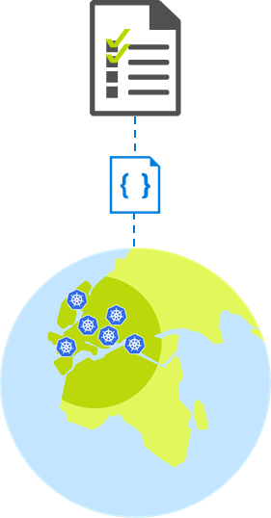
Customer scenario – At-scale Kubernetes App management
Overview
A retailer with 100s of stores would like to move all in-store applications to containers running on a K8s clusters.
They are faced with the challenge of how to uniformly deploy, configure and manage their containerized applications across multiple locations.
Business requirements
Bootstrap a new store to fully run with the applications and configuration that this store requires
Enable IT to apply and monitor at scale governance across all stores
Monitor the state of applications and configuration in all stores
Integrate DevOps and Safe Deployment Practices for applications running in stores
Allow region/store IT to monitor and troubleshoot configuration issues for their stores

Slide 42
Customer scenario - solution
Azure Management
(Azure Resource Manager, Azure Policy, Azure Portal, API, CLI…)
Key benefits from Azure Arc
Asset organization and inventory with a unified view in the Azure Portal across all locations
At scale configuration and deployment based on subscription, resource groups, and tags
GitOps-based model for deploying configuration as code to one or many clusters
Application deployment and update at scale
Source control based Safe deployment procedures when rolling new applications and configurations
Developer tooling agnostic - Use the tools they want.
Azure Arc

Slide 45

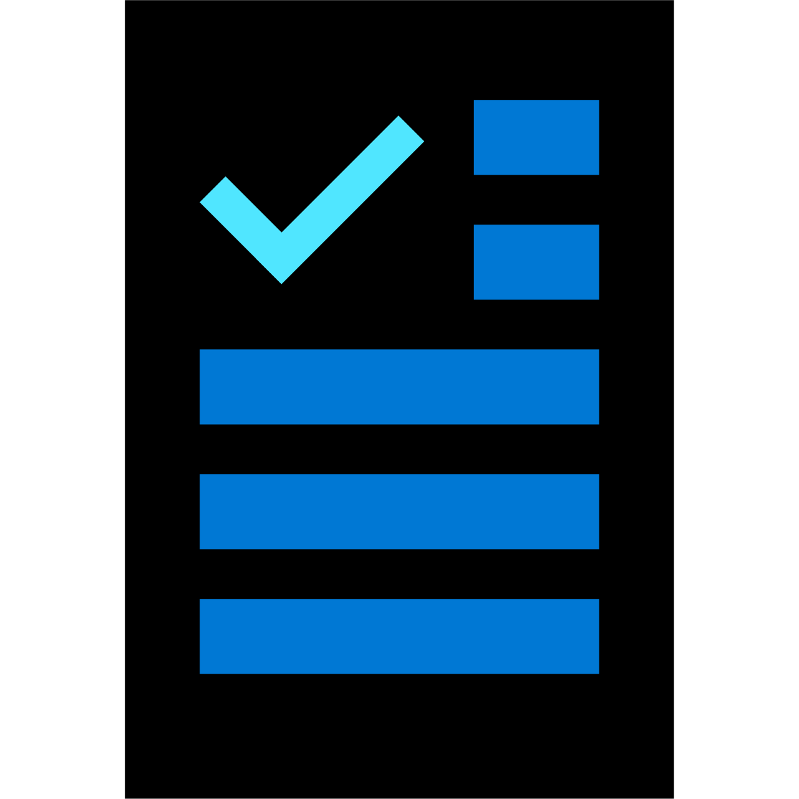


Enforce policies as part of the development process
1
Ensure compliance
2
Empower DevOps
Shift left to deliver compliant code faster
Manage costs
3
Pre-flight
Code
Build/Test
Deploy
Operate
Validation
Policy as Code
Authoring
Policy
Security
Monitoring
Azure DevOps
Notes:
So we have talked about the shift in roles from Ops to cloud custodian, and how the cloud custodian is an enabler instead of a blocker. Lets look at how the cloud custodian can make that happen in the CI/CD pipeline through Azure Policy.
Code, Build/Test, Deploy, Operate– a tube and move the policy from the operate side to the build side. The migration tube polled out with red.
Right now all compliance processes during the devops lifecycle happen at the end of the cycle. These are all the manual checks and approval processes that need to be completed before code is committed and merged.
We are allowing cloud custodians to shift the compliance process left. Now policies are enabled from the beginning, which means that as code is been developed, Azure Policy flags any compliance issues proactively so developers can make the required changes right away and commit their code knowing that it is fully complaint.

Slide 46
Enforce policies as part of the development process
1
Ensure compliance
2
Empower DevOps
Shift left to deliver compliant code faster
Manage costs
3
Pre-flight
Code
Build/Test
Validation
Deploy
Operate
Policy as Code
Authoring
Policy
Security
Monitoring
Azure DevOps
Azure Policy
Notes:
So we have talked about the shift in roles from Ops to cloud custodian, and how the cloud custodian is an enabler instead of a blocker. Lets look at how the cloud custodian can make that happen in the CI/CD pipeline through Azure Policy.
Code, Build/Test, Deploy, Operate– a tube and move the policy from the operate side to the build side. The migration tube polled out with red.
Right now all compliance processes during the devops lifecycle happen at the end of the cycle. These are all the manual checks and approval processes that need to be completed before code is committed and merged.
We are allowing cloud custodians to shift the compliance process left. Now policies are enabled from the beginning, which means that as code is been developed, Azure Policy flags any compliance issues proactively so developers can make the required changes right away and commit their code knowing that it is fully complaint.

Slide 47
Customer scenario – Run Azure data services anywhere
Overview
An Energy company aims for an efficient and fully automated operation with AI everywhere.
Customer operates various production sites, as well as run utility transporting from extraction to retail distribution. Massive data volume at the edge and need real-time insights.
Business requirements
Leverage existing OEM hardware and OpenShift K8s
Automation at scale for IT control systems e.g. HA/DR, backup, CI/CD, DevOps
Latest innovation automatically deployed from edge to cloud
Consistent security and governance
Private Cloud - Enterprise business systems challenges
Lots of manual effort for CI/CD, especially for data tier
Variety of DB engines, with versions facing EOS, security siloes; no elastic scale
Mix of containers and VMs on OEM hardware
Azure data services
Fully managed services only available in Azure
Data Aggregation
Model updates
Operational databases
Analytics solutions
Edge – real-time processing challenges
Custom code needed for streaming, data sync and AI
Legacy, basic database with no AI built
Sensors
Actuators
OEM edge servers/workstations

Slide 48
Customer scenario – solution
Key benefits from Azure Arc
Any infrastructure, any K8s
Always on the latest, no end-of-support with evergreen SQL in Azure SQL DB
Elastic scale on-premises with PostgreSQL Hyperscale
Azure SQL Database Edge with built-in AI for real-time edge analytics
Automation at scale with unified management of all data & AI assets
Market leading security & governance consistently deployed everywhere
Private Cloud - Enterprise business systems
Automated APIs with K8s for fast CI/CD
Azure SQL Database on Azure Arc, no EOS; Azure Database for PostgreSQL Hyperscale on Azure Arc
K8s of choice on any OEM hardware
Azure data services
K8s management
Azure Policy
Azure Role-based control
Azure Security Center
Azure Arc
Operational databases
Analytics solutions
Edge – real-time processing challenges
No custom code needed, AI and streaming built-in to database
Azure SQL Database Edge with built-in AI, consistent security
Sensors
Actuators
OEM edge servers/workstations

Slide 49

Azure data services anywhere
Bring Azure data services to any infrastructure with Azure Arc
Always current
Elastic scale
Unified management
Unmatched security
Cloud billing
Automated patching/updates based on customer policy
Hyperscale innovation now available on-premises
Evergreen SQL with no end-of-support
Deploy in seconds
Scale up/down, scale out based on capacity
Automation of DB tasks at scale, e.g. high availability
Single view across on-prem and public cloud
Integrated management across data infrastructure and operations
Access to Azure Advanced Data Security
Consistent governance with Azure Policy & Role-based Access Control
Modern cloud billing model across hybrid infrastructure
Leverage existing licensing investments with Microsoft
Any hardware, any Kubernetes

Slide 50
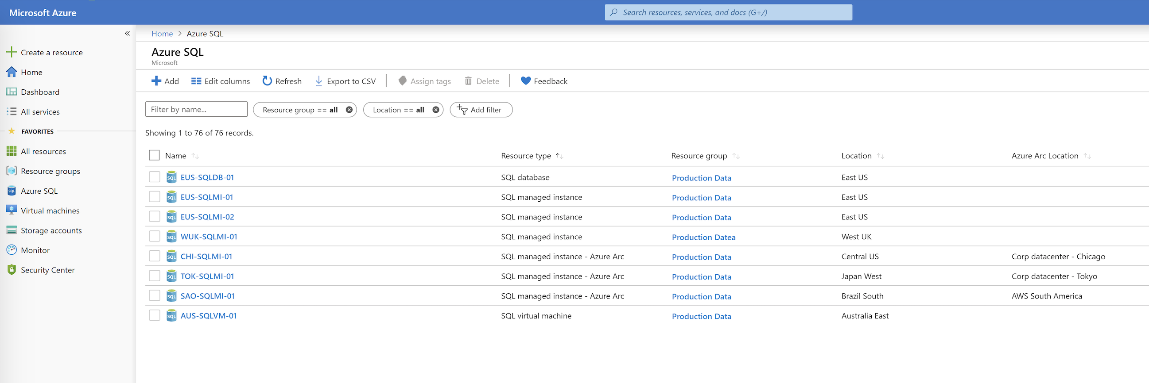

Slide 52


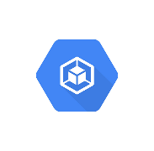
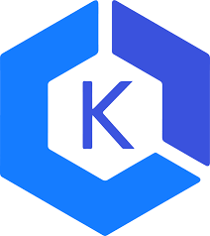
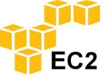
Azure data services anywhere at a glance
Apps and BI
Custom apps
BI
Analytics
Azure data services
…
Provisioning
Updates
Azure Arc management
HA/DR
Backup
Microsoft Azure Site Recovery
Scaling
Diagnostics
Azure Security
Monitoring
Azure Site Recovery
Any Kubernetes
Kubernetes
OPENSHIFT
AKS
GKE
EKS
Any hardware
OEM hardware

Slide 53
Azure Management Single Control Plane for Azure resources
Management Services
Monitoring | Update | Containers | Backup | Security Center | More…
Tools and experiences
Portal
Shell
Bash
CLI
Ecosystem
Marketplace
Access and security
RBAC | Locks | Subscriptions
Organization and inventory
Search | Index | Groups | Tags
Azure Customers
Azure Resource Manager
Environments and automation
Templates | Extensions
Governance and compliance
Logs | Policy | Blueprints
Over 200 services
Extensibility for new Resources
Azure Services
Azure

Slide 54
Azure Arc Components
Azure
Customer locations
Azure Resource Manager
Azure Data Services
Management experiences
Wave 1
SQL
PostgreSQL
Resource specific tools
Azure Arc data agent
Azure Data Studio
Azure Portal
Identity
Azure Arc data RP
Azure Arc data controller
Azure CLI
RBAC
Kubernetes
K8s Native Tools
Azure SDK
Container registry
Policy
GitOps Manager
Azure PaaS Control
Cluster provisioning​
Cluster upgrade and patch management​
Cluster lifecycle management​
Cluster monitoring
Index
Azure Arc K8s RP
Azure Arc K8s agent
K8s Cluster
Groups
Azure Arc server RP
Servers
Etc.
Azure Arc server agent
Linux
Server Admin Tools
Azure Arc server agent
Windows Server
Azure Arc:

Slide 55
Thank you.

Slide 56
Customer scenario Run Azure Data Services anywhere
Overview
An Energy company aims for an efficient and fully automated operation with AI everywhere
Customer operates various production sites, as well as run utility transporting from extraction to retail distribution
Massive data volume at the edge and need real-time insights
Business requirements
Leverage existing OEM hardware and OpenShift K8s
Automation at scale for IT control systems e.g., HA/DR, backup, CI/CD, DevOps
Latest innovation automatically deployed from edge to cloud
Consistent security and governance
Private Cloud—Enterprise business systems challenges
Lots of manual effort for CI/CD, especially for data tier
Variety of DB engines, with versions facing EOS, security siloes; no elastic scale
Mix of containers and VMs on OEM hardware
Azure Data Services
Fully managed services only available in Azure
Data aggregation
Model updates
Operational databases
Analytics solutions
Edge—real-time processing challenges
Custom code needed for streaming, data sync and AI
Sensors
Legacy, basic database with no AI built
Actuators
OEM edge servers/workstations

Slide 57
Customer scenario Solutions
Key benefits from Azure Arc
Any infrastructure, any K8s
Always on the latest, no end-of-support with evergreen SQL in Azure SQL DB
Elastic scale on-premises with PostgreSQL Hyperscale
Azure SQL Database Edge with built-in AI for real-time edge analytics
Automation at scale with unified management of all data & AI assets
Market leading security & governance consistently deployed everywhere
Private Cloud—Enterprise business systems challenges
Automated APIs with K8s for fast CI/CD
Azure SQL Database on Azure Arc, no EOS; Azure Database for PostgreSQL Hyperscale on Azure Arc
K8s of choice on any OEM hardware
Azure Data Services
K8s management
Azure Policy
Azure Role-based control
Azure Security Center
Azure Arc
Data aggregation
Model updates
Operational databases
Analytics solutions
Edge—real-time processing challenges
No custom code needed, AI and streaming built-in to database
Sensors
Azure SQL Database Edge with built-in AI, consistent security
Actuators
OEM edge servers/workstations

Slide 58
Azure Data Services anywhere
Bring Azure data services to on-premises, multi-cloud, and edge with Azure Arc
Always current
Elastic scale
Unified management
Unmatched security
Cloud billing
Automated updates
Evergreen SQL
Hyperscale on-premises
Deploy in seconds
Scale up, scale out
Automation at scale
Single view for
on-prem and clouds
Use familiar tools
Advanced Data Security
Azure Policy
Role-based Access Control
Cloud billing on-premises
Cost efficiency
Any hardware, any Kubernetes

Slide 61
Azure Hybrid comparison

Slide 62
Five characteristics of a trusted hybrid cloud provider
Only Microsoft delivers across the board
1
2
3
4
5
Comprehensive continuum across on-premises, multi-cloud, edge, and disconnected scenarios
Allow you to maximize investment in existing infrastructure and bring cloud services to any infrastructure
Offer a control plane to manage and secure any resource on-premises and across multiple clouds
Support key needs including data sovereignty, regulations and operating in harsh environments
Have an ecosystem across hardware OEMs, SIs, and ISVs to support diverse needs and geos

Slide 63


Azure Hybrid comparison
Single control plane across on-premises, multi-cloud and edge | Cloud services and management to any infra | None
Bring cloud services to any infrastructure | Azure data services on any K8s Azure data services multi-cloud support | RDS on VMware No multi-cloud support
Modernize datacenters | Disconnected /not managed Choice of hardware vendors More Azure services Available in 100+ geos/first to market Cloud-connected HCI solution | Managed experience/no disconnected No choice of hardware vendor Limited AWS services New to market No HCI option
Extend to the Edge | Edge/ML/AI scenarios and network data transfer Containers and IoT Edge support | Primarily network data transfer No containers or IoT support

Slide 64


Guide to evaluating your hybrid cloud solution
Guide to evaluating your hybrid cloud solution
Solution needs
Does your business have security, regulations or other restrictions that require you to operate in environment that isn't connected to the internet? Do you want to block data from being sent to a public cloud? | Azure Stack Hub Azure Stack HCI Azure data services on Azure Arc | X
Do you want to run ML models to get quick results that can be acted on before the data is sent to the cloud? Do you want to analyze and react to IoT events at the edge? Do you want to leverage AI-inferencing and hardware acceleration? | Azure Stack Edge (SW—Azure IoT Edge) | X (Software—AWS Greengrass)
Are you managing a multi-cloud environment with edge resources and services across a variety of platforms? | Azure Arc | X
Do you want the flexibility to deploy up-to-date data capabilities on-premises? Do you see spikes in usage and want the ability to scale seamlessly? | Azure data services on Azure Arc | RDS on VMware
Are you managing Windows and Linux servers across clouds, datacenters and edge? | Azure Arc | X
Do you want to deliver cloud capabilities in the harshest environment conditions supporting scenarios such as tactical edge, humanitarian and emergency response efforts? | Azure Stack Edge rugged series | X
Do you want a consistent threat detection and security analytics across on-premise and cloud infrastructure? | Azure Sentinel | X
Do you want to consolidate traditional virtual apps to combine storage, compute, and networking into a software-defined system with hyperconverged infrastructure (HCI)? | Azure Stack HCI | VMWare on Outposts
Pay monthly for hardware; cloud billing for on-premises data workloads | Azure Stack Edge Azure data services on Azure Arc | AWS Outposts RDS on VMware

Slide 65
Get started
Sign up for Data Services and Kubernetes on Azure Arc
https://aka.ms/AzureArc
Read more
https://aka.ms/Azure-Arc-Info
https://azure.microsoft.com/en-us/blog/azure-arc-extending-azure-management-to-any-infrastructure/
Start managing servers today!
https://Aka.ms/hybridmgmt
Microsoft Azure
Azure Arc
Any datacenter, any cloud

